Slide 1
DIGITAL TOOLS FOR​ STRATEGIC PLANNING (DOORSTEP)​
ANAlysis of COVID-19 (Delta Variant)
Advanced Systems Engineering Prof. Dr.-Ing. Roman Dumitrescu
Avinash Kumar, Vamsi Krishna, Vishwas Narayan​ MS Teams | August 13, 2021​

Slide 2
Presentation Outline
Initial analysis of Delta Variant
Introduction
Impact of Delta variant on the world
Impact of Delta variant on India, United Kingdom and Russia
India
Situation in India due to delta surge
Reasons for rise in delta variant.
United Kingdom
Situation in United Kingdom due to delta surge
Reasons for rise in delta variant.
Russia
Situation in Russia due to delta surge
Reasons for rise in delta variant.
Analysis and Prediction of COVID-19 cases and deaths in Germany
Conclusion and Response Options: German Government handling COVID-19

Slide 3
Analysis of Delta Variant
1

Slide 4
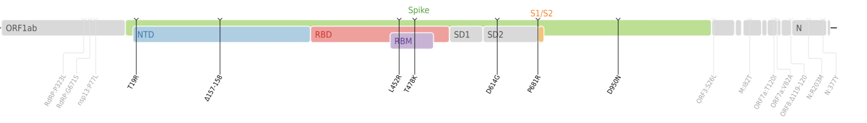
What is Delta variant??
Renamed as “Delta Variant” by the WHO,B.1.617.2 is a variant of lineage B.1.617 of SARA-COV-2.
The variant has 13 mutations like D614G,T478K etc.
It is easily transmittable and variant of severe concern.
This variant predominantly has a different set of symptoms like headache , soar throat or a runny nose.
https://en.wikipedia.org/wiki/SARS-CoV-2_Delta_variant

Slide 5
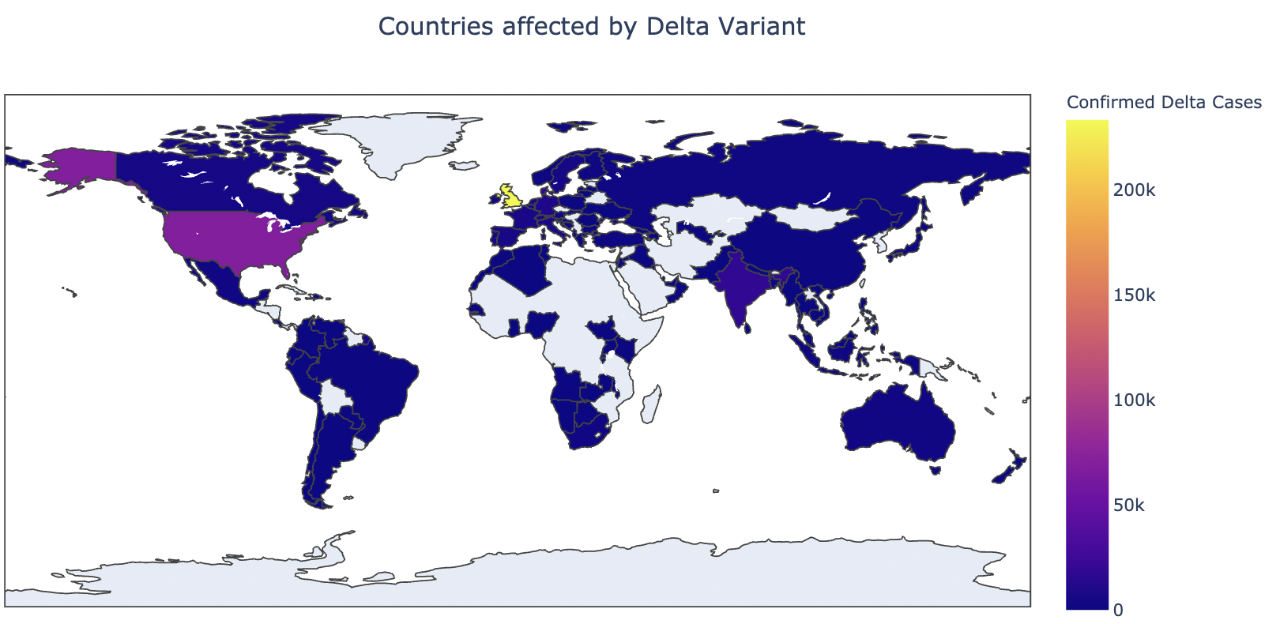
Impact of Delta Variant on the world
Total of 433k confirmed delta variant cases have been reported around the world.
120 countries have reported Delta variant cases.
United Kingdom is the most affected country by delta variant.

Slide 6
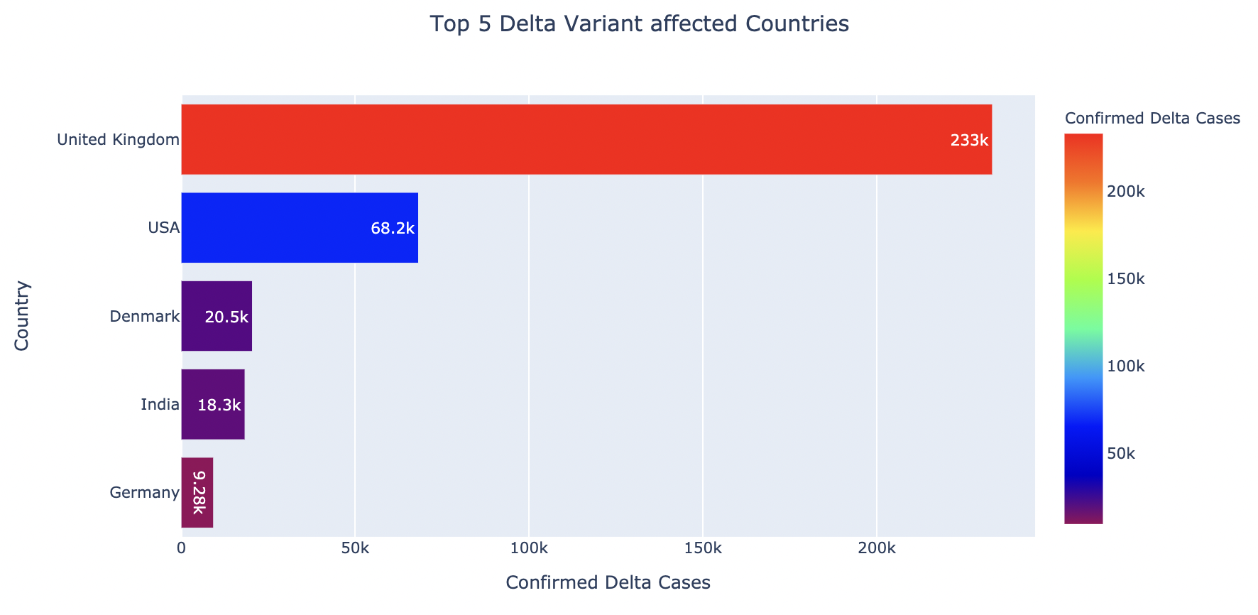
Top five Delta Variant affected countries
United Kingdom consists of 60 percent of all the delta variant cases around the world.
Denmark is having one of the highest delta cases per population.

Slide 7
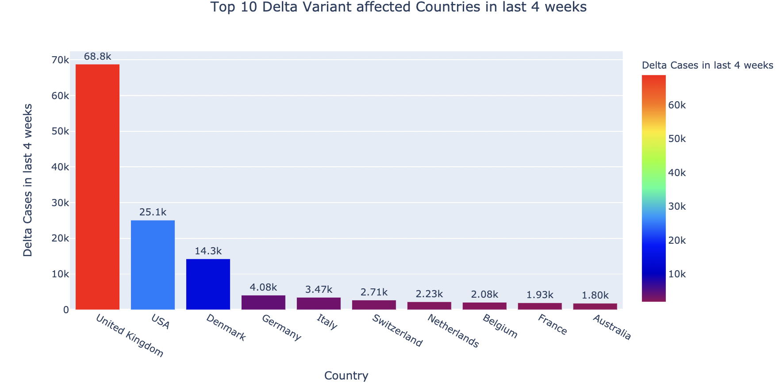
Top 10 Delta Variant affected Countries in last 4 weeks
United Kingdom has recorded the highest number of delta variant cases in last 4 weeks
Most of the European countries are affected by delta variant.

Slide 8
Delta Variant Situation in United kingdom, india and russia

Slide 9
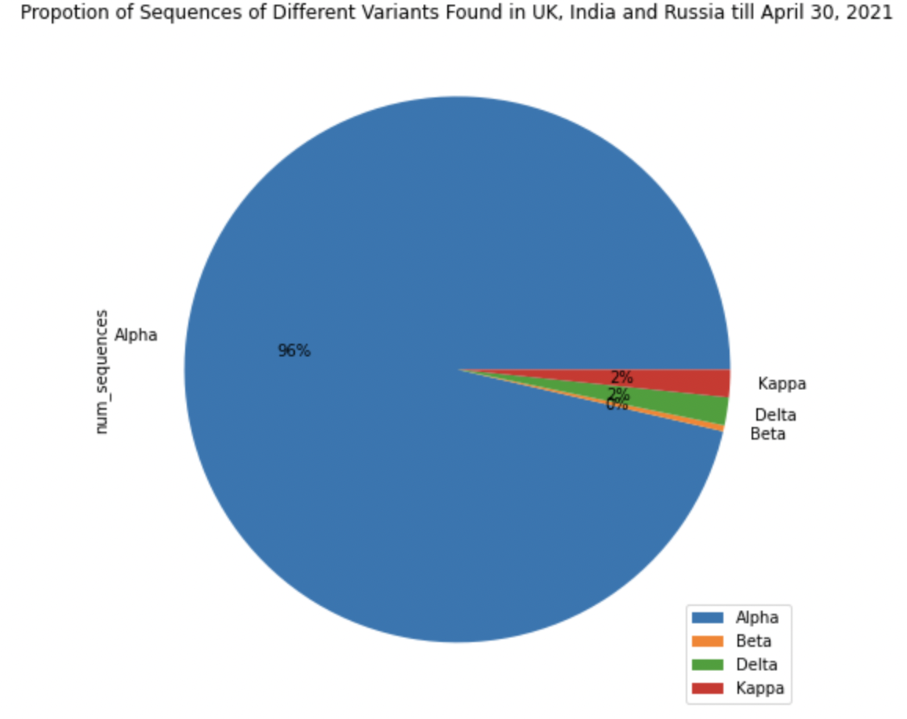
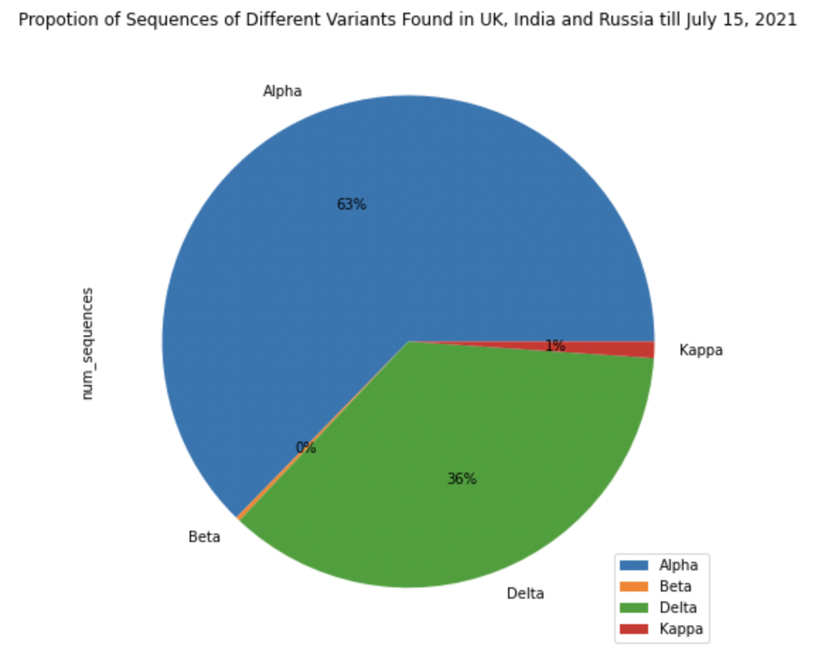
Impact of Delta Variant in last 3 months
Only 2 percent of all the variants found to be delta variant by the end of April 2021.
Significant increase of delta variant in the last few months.

Slide 10
COVID19 situation in India due to delta variant

Slide 11
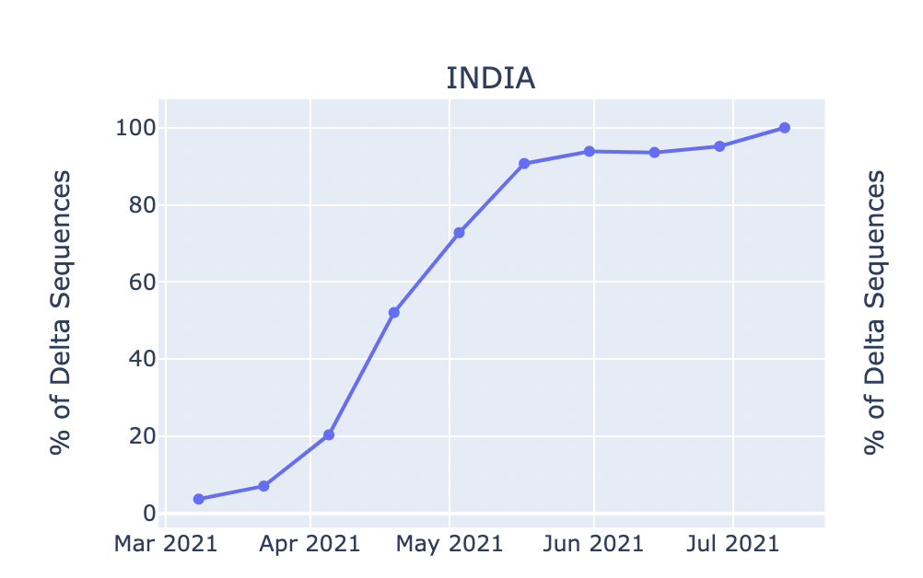
Increase of Delta variant cases in India
First Delta variant identified in India on 5th October 2020.
Upward trend in delta variant started from the month of April 2021.
Almost all the variant sequences coming out to be delta variant from the month of July.

Slide 12
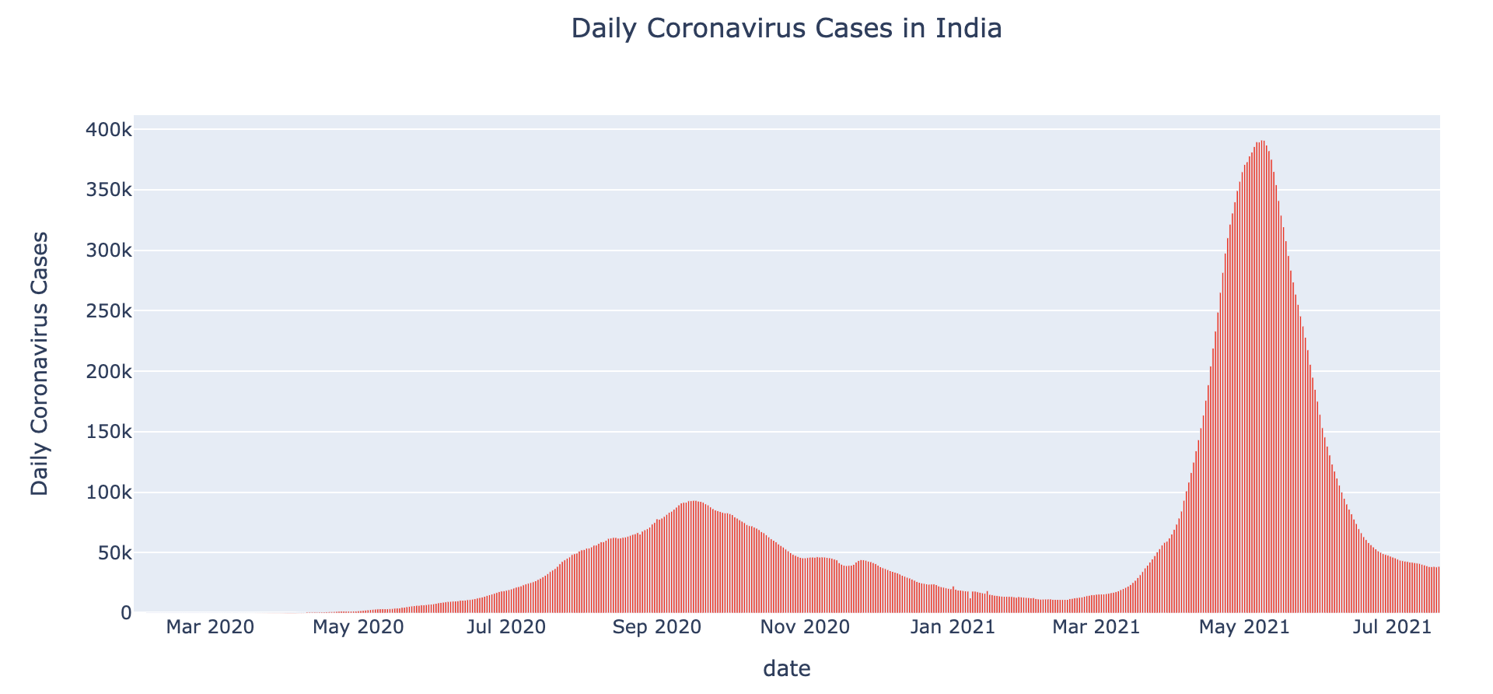
Lockdown in 2021
Lockdown in most of the cases
Lockdown in most of the states by the end of April

Slide 13
Reasons for Delta Surge

Slide 14
No Lockdown
No Lockdown
India opened everything by the end of October 2020.
No lockdown was implemented even when covid cases started rising up.

Slide 15
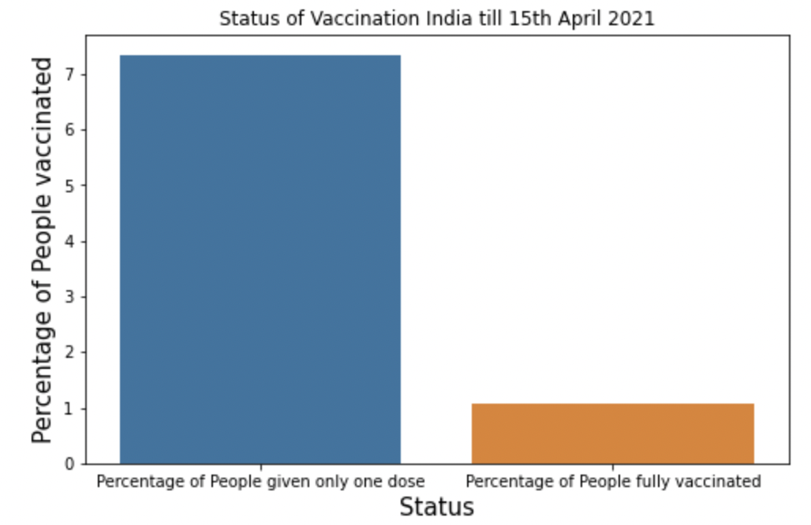
Slow Vaccination
An obtuse pace of vaccination before second wave of Covid19.
Very few people were given one dose before mid of April.
Only 1 percent people were fully vaccinated.
7.03 Percent
1.06 Percent

Slide 16
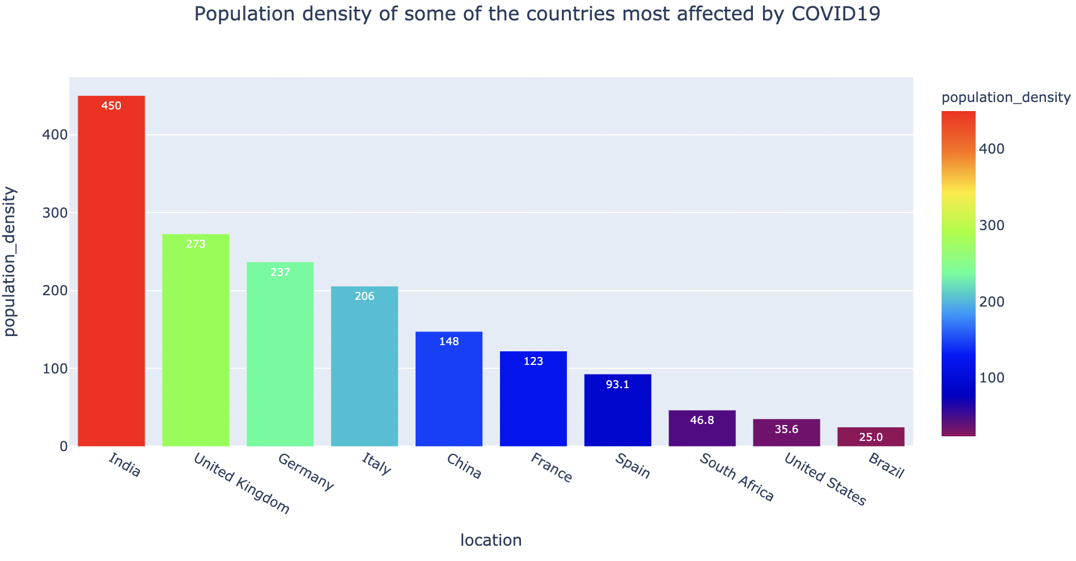
High Population density
India is world’s second most populous county with population of more than 1.3 billion people.
Cities like Delhi, Mumbai, Kolkata and Chennai having population more than 10 million.
India’s population density is far higher than other countries, affected by COVID19.

Slide 17

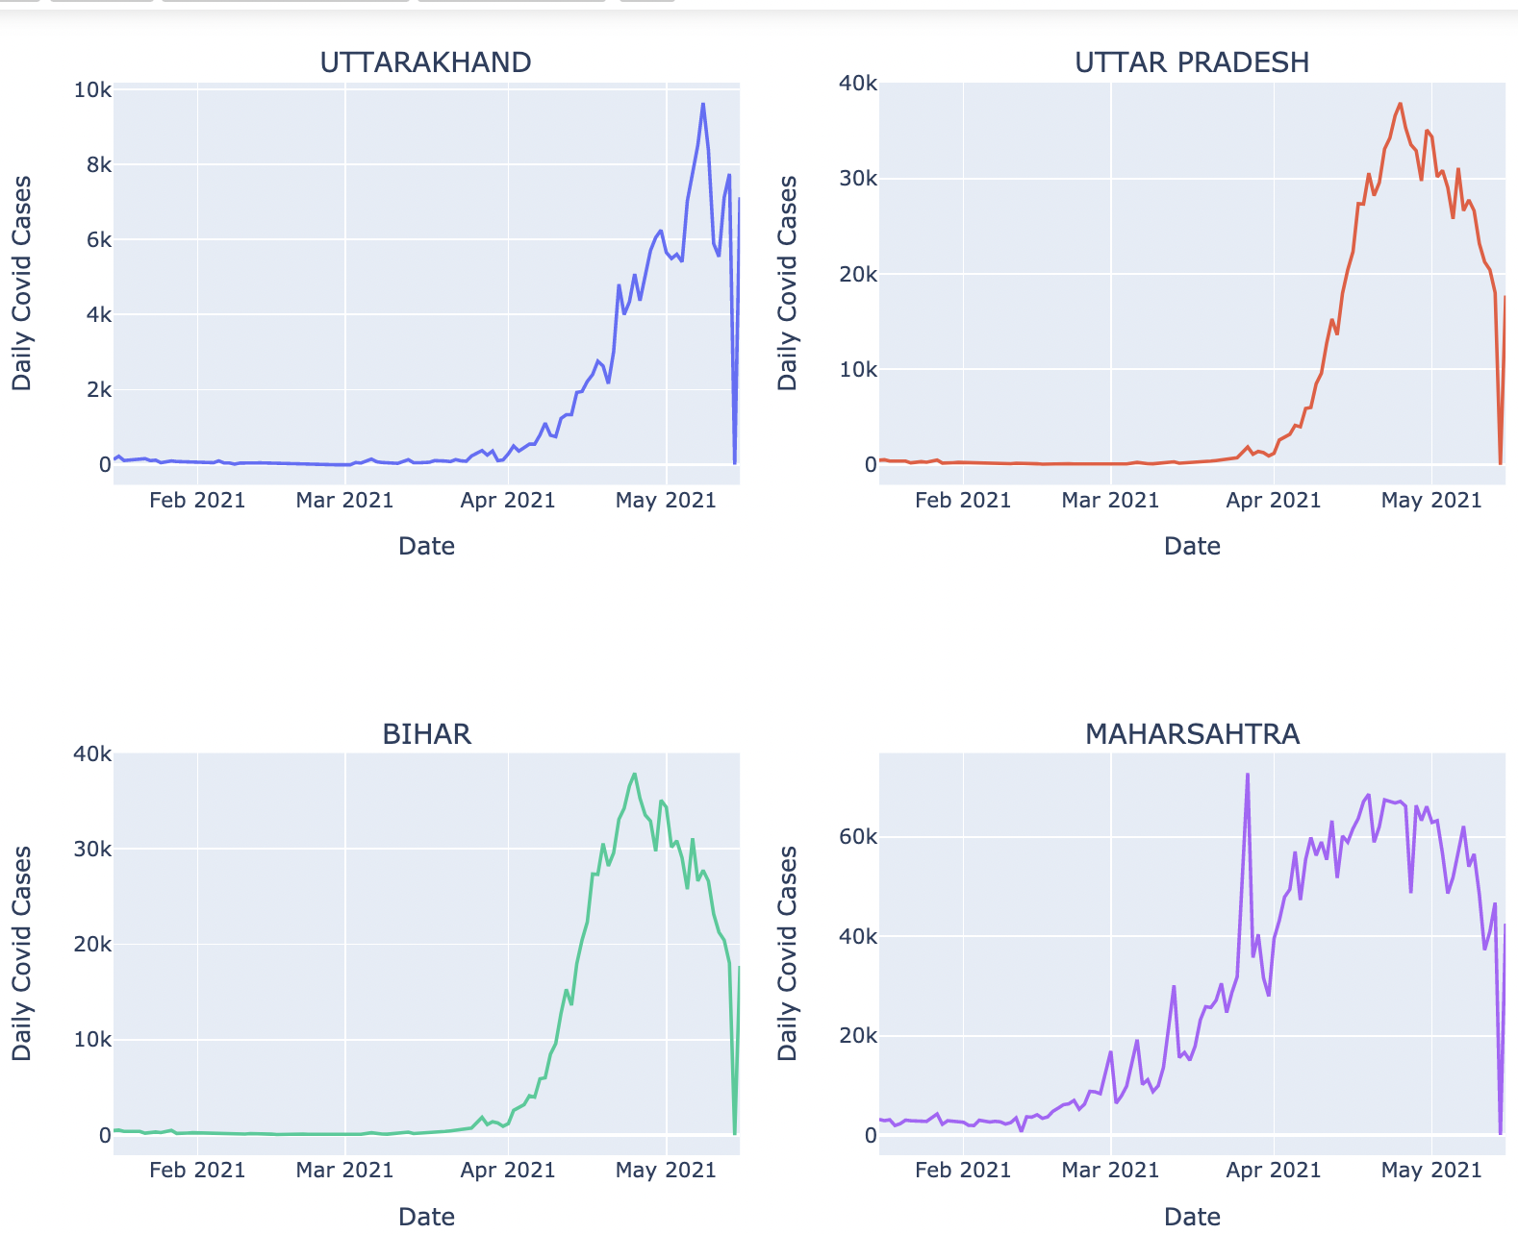
Kumbh Mela in April 2021
During the 1st week of April, religious congregation happened in the holy city of Haridwar.
9 million gathered for the festival without any social distancing measures, making it a super spreader event.
During April 10-14, 1701 attendees tested positive for the COVID. Source: The Hindu
Most of the attendees came from the state of Uttarakhand, Uttar Pradesh, Bihar and Maharashtra.
Image Source:- india.com
https://www.theguardian.com/world/2021/may/30/kumbh-mela-how-a-superspreader-festival-seeded-covid-across-india

Slide 18

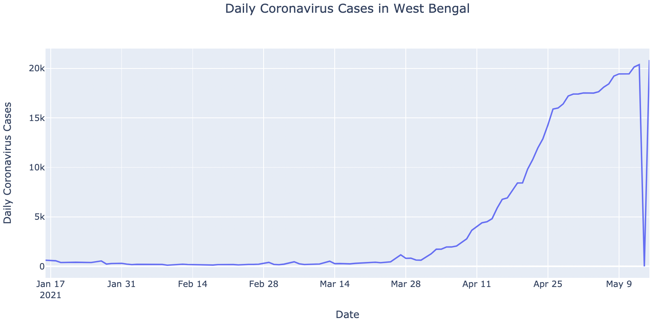
West Bengal Elections
State Elections happened from 27th March to 29th April 2021.
Every political party did rallies during during the month of march.
Huge gathering of people during rallies, making the super speader events.
Huge increase of Covid in West Bengal after elections.
Source:- Hindustan Times

Slide 19
COVID19 situation in United kingdom due to delta variant

Slide 20
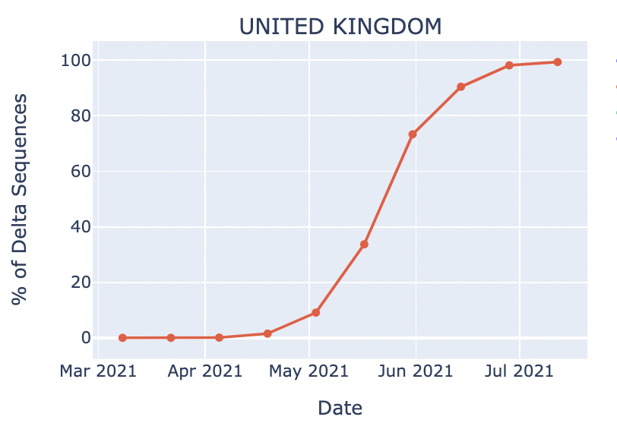
Increase of Delta Variant Cases
United Kingdom has total of 233k confirmed delta variant cases.
It has recorded 68.8k cases in the last four weeks.
Upward trend in delta sequences started from the month of May.

Slide 21
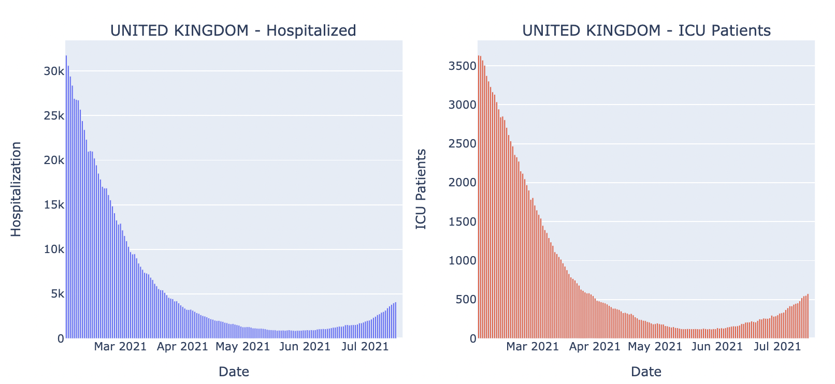
Increase in Hospitalization
Hospitalization rate decreased considerably before May 2021.
Similar trend in hospitalization and ICU patients after delta variant became more vibrant.

Slide 22
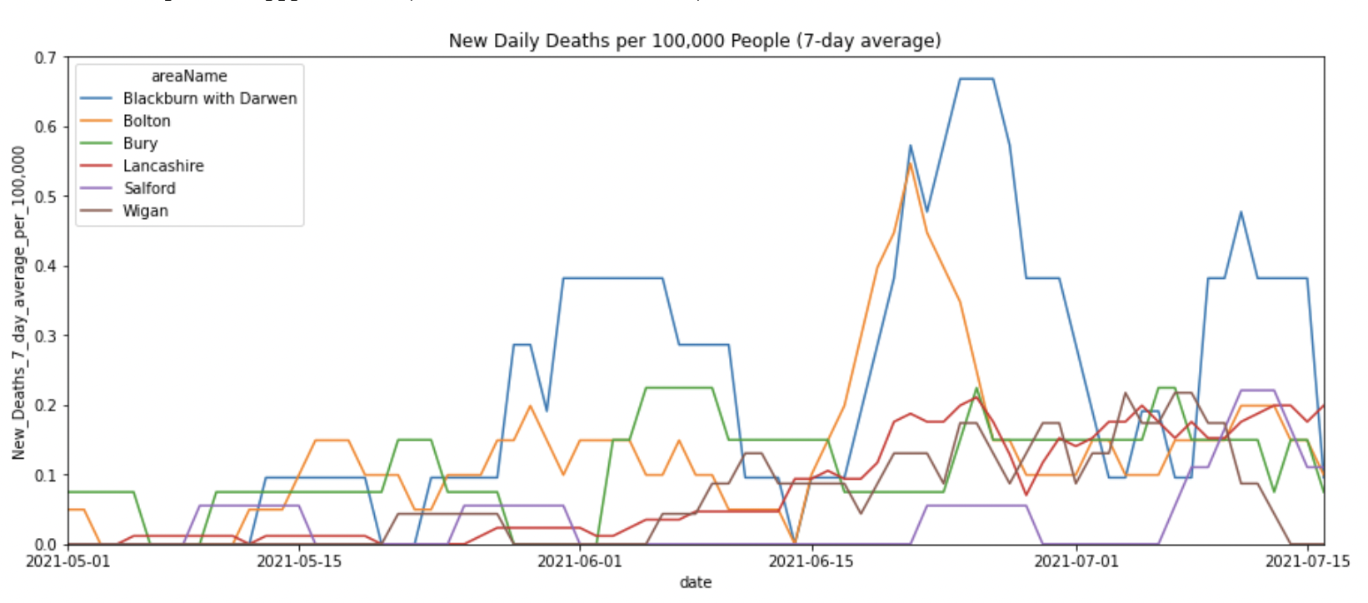
Increase in daily deaths
Majority of United Kingdom regions show increase in deaths after the delta variant surge.
Significant number of deaths in the month of June and July.

Slide 23
Reasons for Delta Surge

Slide 24
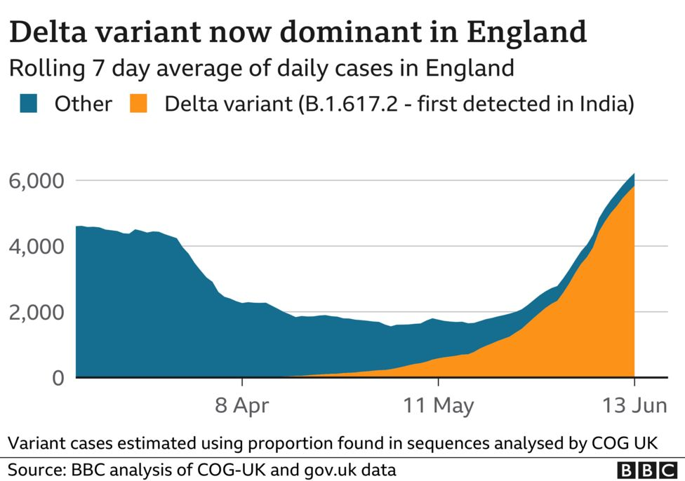
Travel to United Kingdom
The first sequence of Delta in UK has been found on March 08 2021.
India, which was the worst affected country by Delta variant of COVID has been put on red list from April 23th 2021 by the UK govt.
According to the Civil Aviation Authority around 42,000 people have travelled to UK from India.
Which predominantly was assumed to be the reason for sudden spike in Delta cases in UK.
https://www.bbc.com/news/health-57489740
Source of facts : https://www.bbc.com/news/57500637

Slide 25
COVID19 situation in Russia due to delta variant

Slide 26
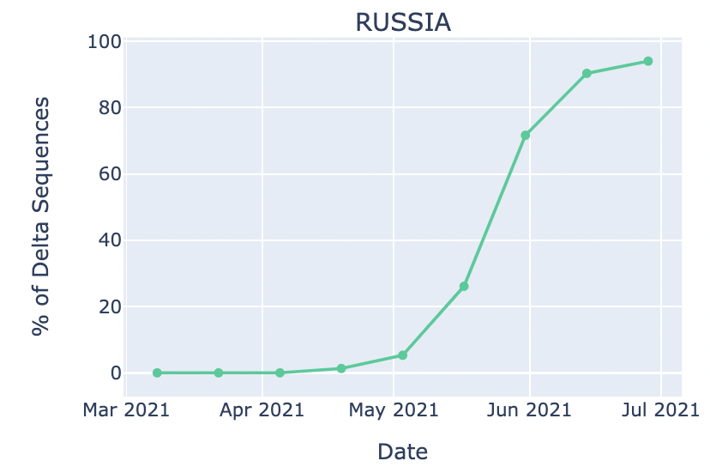
Rise of Delta Variant sequences
Russia has total of 1600 confirmed delta variant cases.
160 covid cases are sequenced to delta in past 4 weeks.

Slide 27
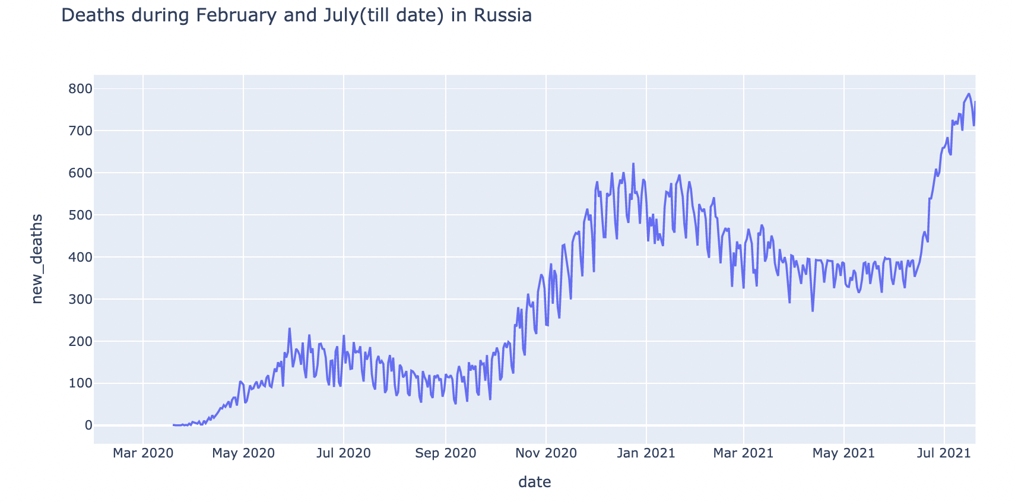
Increase in the daily deaths
Significant number of deaths recorded in the month of July due to delta variant.
Daily deaths rise to 800.

Slide 28
Reasons for Delta Surge

Slide 29
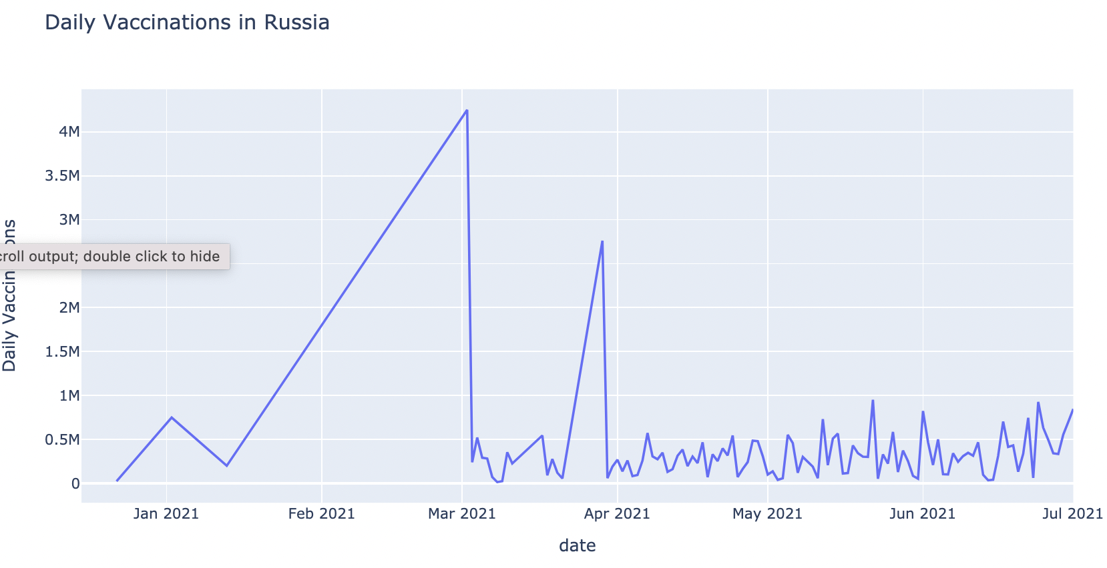
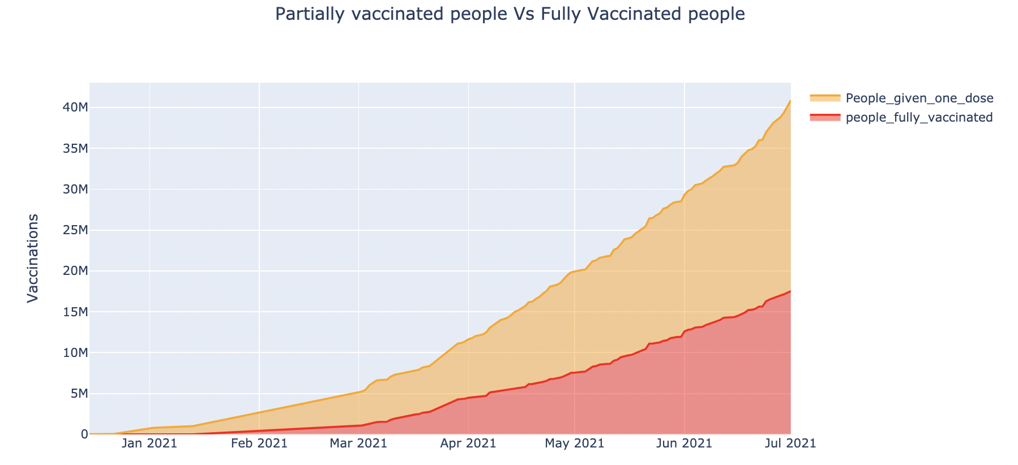
Low Vaccination
Low Vaccination
Russia’s vaccination drive was slow from the month of April 2021.
Fully vaccinated people by the end of April is only 5 percent.

Slide 30
Inferences and Conclusion of the analysis of Delta variant
Delta variant is the most prominent mutatation of COVID19 in recent times.
It is responsible for majority of the new COVID cases in many countries.
India’s second COVID wave was very dangerous due to the
Some of the reasons for delta surge in India is Low vaccination, high population density and super speaders events like Kumbh Mela and West Bengal Elections
United Kingdom is severely affected by the delta variant with 90 percent of new sequences coming from delta.
Travel to United Kingdom, particularly from India during the early 2021 was resoponsible for delta varint surge.
Russia recent dily cases and deaths have increased due to delta variant.
One of the reason for delta surge in Russia is due to low vaccination before the month of Apri 2021.

Slide 31
Analysis and prediction of covid-19 cases and deaths in Germany
Analysis and Prediction Approach
Exploratory Data Analysis on COVID-19 Data
Short-Term Forecasting of Cases and Deaths due to Delta Variant
SEIR Model for Forecasting of Cases and Deaths due to Delta Variant

Slide 32
Analysis and Prediction Approach for COVID-19 cases and deaths in Germany
1
Raw Data Collection, Data Preparation and Data Pre-processing to perform Initial Exploratory Data Analysis to determine Cumulative COVID-19 cases and deaths
2
Summarization of the main characteristics of the datasets using EDA to visualize Recent Trend of COVID-19 (Delta Variant)
3
5
4
Application of various Machine Learning Regression models on the datasets to perform short-term prediction of COVID-19 cases and deaths
Application of SEIR model (Effective modelling approach in Epidemiology) to forecast COVID-19 cases with more accuracy
Data Visualizations of different prediction models to obtain key insights for enabling effective decision making on handling COVID-19 spread due to Delta Variant

Slide 33
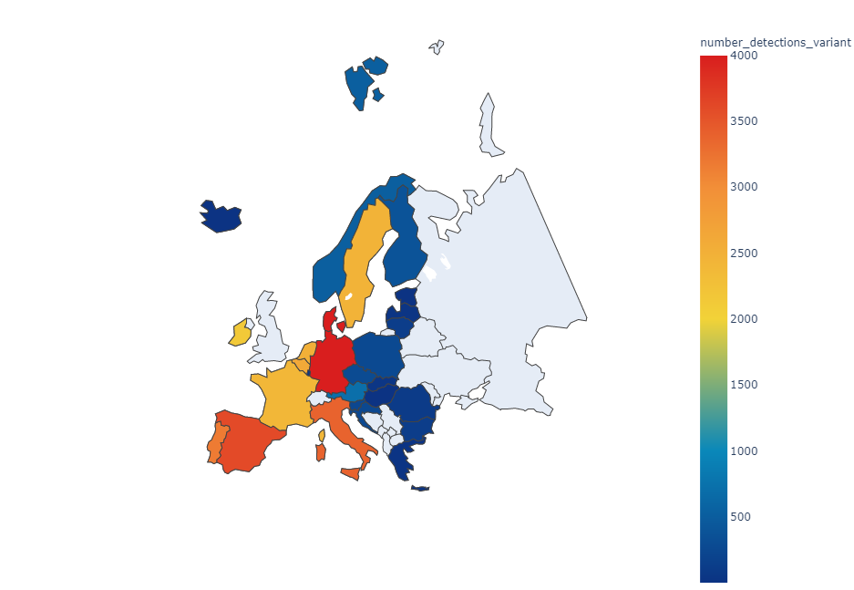
Rise of Delta Variant Cases in the European Union
Germany has one of the highest number (4632/137463)
of delta variant cases in the EU

Slide 34
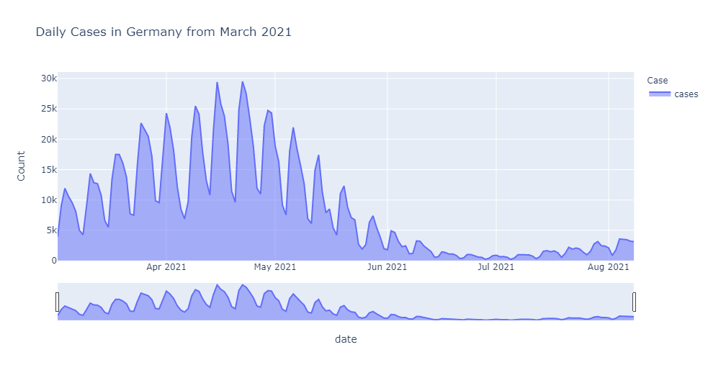
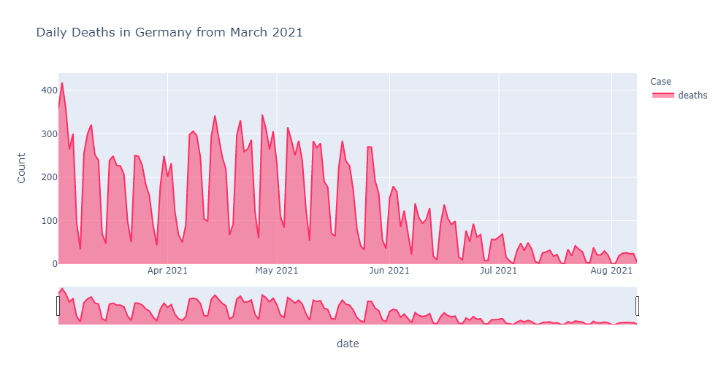
Initial Exploratory Data Analysis on COVID-19 Data
Daily number of COVID-19 cases & deaths
Daily Cases in Germany from March 2021, It is observed that the number of daily cases increases from the March keeps rising till first week of May and falls from second week of May
Daily Deaths in Germany from March 2021, It is observed that the number of daily deaths stays the same for the months of April, May and starts decreasing from the month of June.

Slide 35
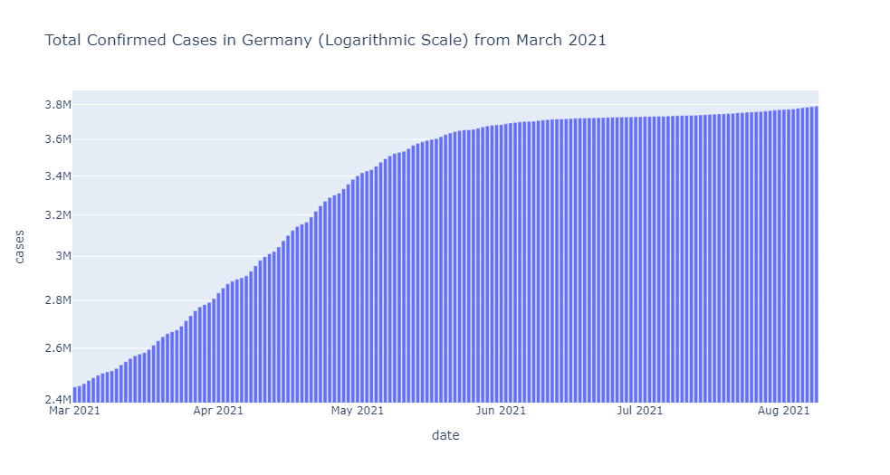
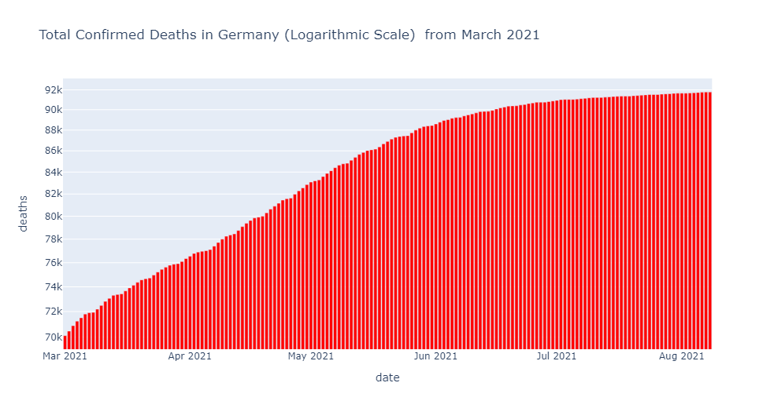
Initial Exploratory Data Analysis on COVID-19 Data
Cumulative number of COVID-19 cases & deaths
Total Confirmed Cases in Germany from March 2021, It is observed that the number of total cases increases gradually from the March keeps rising till June and remains constant
Total Deaths in Germany from March 2021, It is observed that the number of total deaths follows the same patterns as confirmed cases and stays constant from last week of June.

Slide 36
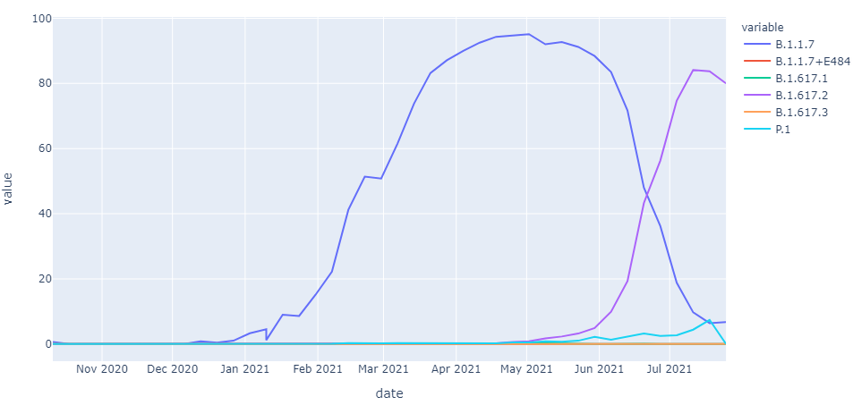
Exploratory Data Analysis on COVID-19 Data
Trend of VOC(Variants of Concern) Distribution(%) in Germany
Inflection point for Alpha Variant
Point of Intersection
Inflection point for Delta Variant
From Dec 2020 – June 2021, The percentage of B.1.1.7(Alpha Variant) cases was most prominent.
From June 2021, The sharp increase in percentage of B.1.617.2 (Delta Variant) cases in Germany.

Slide 37
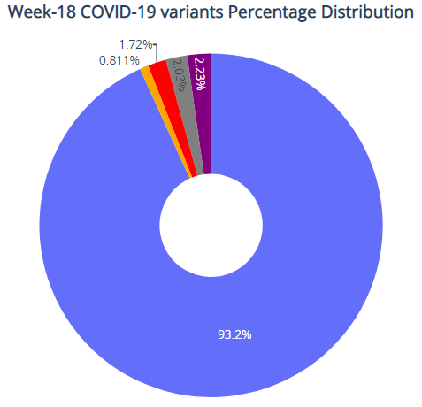
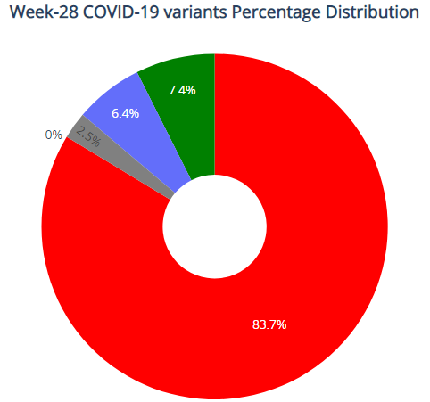
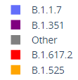
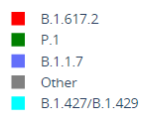
Pie chart Visualization: COVID-19 Variant Analysis from Week-18 to Week-28 2021
Alpha-Variant (B.1.1.7) – The Alpha Variant decreases from 93.2% to 6.4% in the new sequencing of cases
Delta-Variant (B.1.617.2) – The Delta Variant rapidly increases from 1.72% to 83.7% in the new sequencing of cases

Slide 38
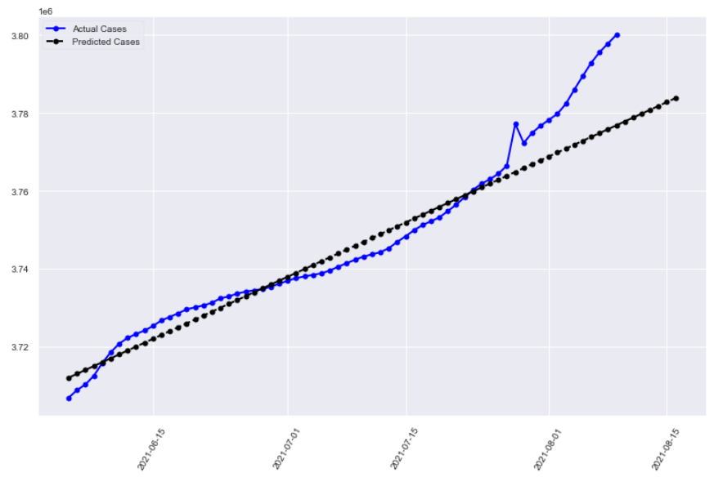
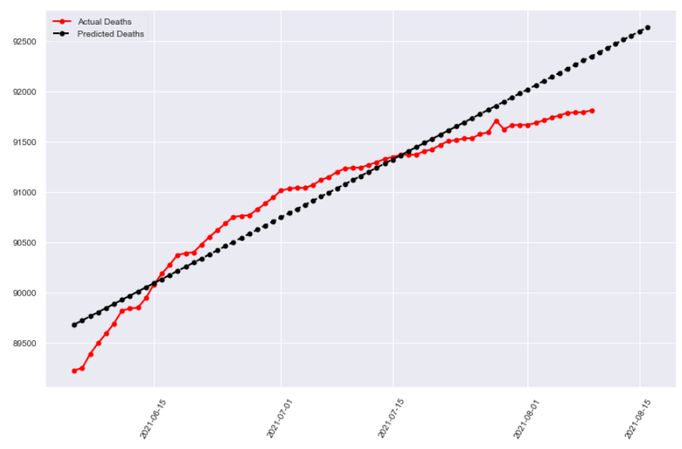
Short-term Prediction of COVID-19 cases and deaths due to Delta Variant
Linear Regression Model
The linear regression model showed considerable results due to cumulative cases did not change much initially and it has notable error rates.
This model cannot forecast significant variations in the number of COVID-19 cases and deaths
Digital Tools for Strategic Planning (DOORSTEP) | August 13, 2021
Notes:
but it can seen that due to delta variant there’s a sharp increase in cases in the beginning of August

Slide 39
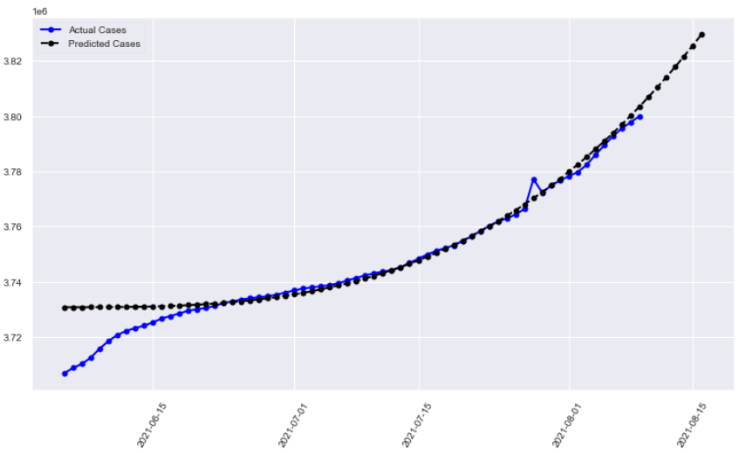
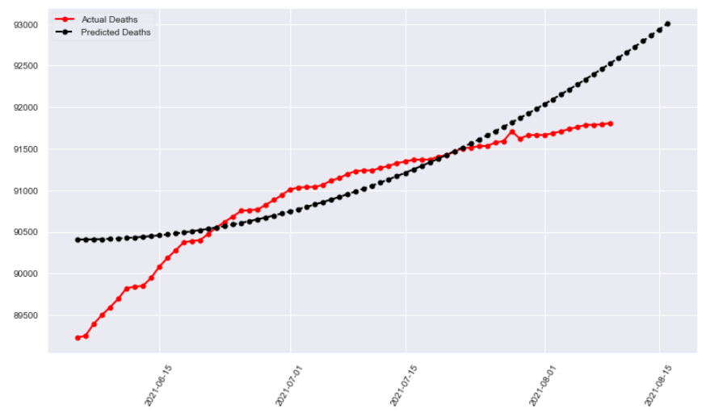
Short-term Prediction of COVID-19 cases and deaths due to Delta Variant
Support Vector Regression Model
The Support Vector Regression performs well for the short-term prediction of the COVID-19 cases with low error rates but it fails to forecast the COVID-19 deaths correctly and has notable error rates with hyperparameter tuning of degree=5
This model partially does the short-term prediction of COVID-19 cases and deaths due to Delta Variant
Digital Tools for Strategic Planning (DOORSTEP) | August 13, 2021

Slide 40
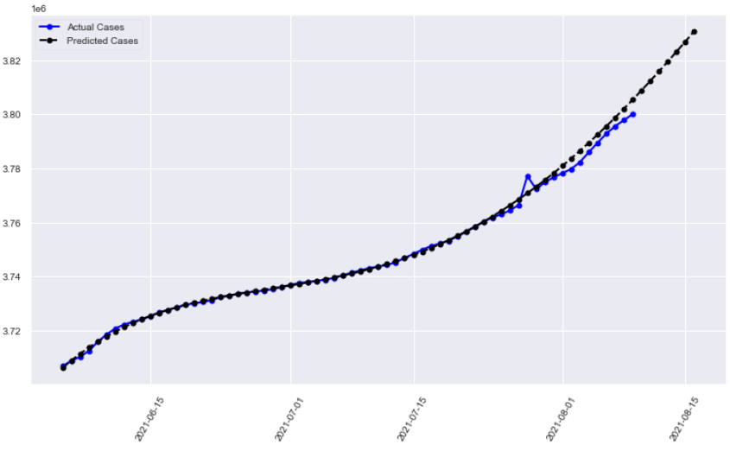
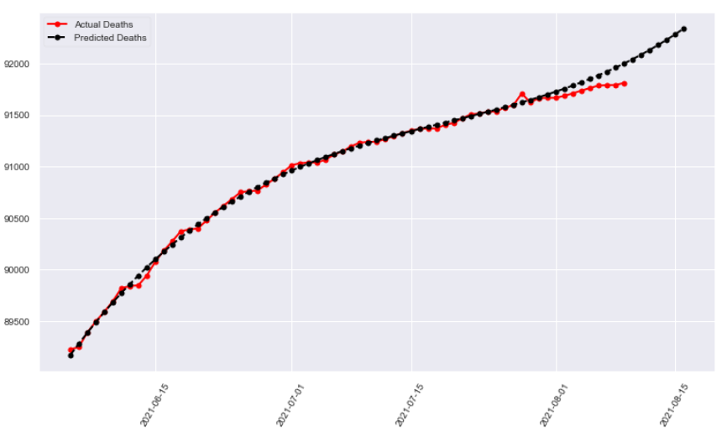
Short-term Prediction of COVID-19 cases and deaths due to Delta Variant
Polynomial Regression Model
The Polynomial Regression Model presents promising results with low error rates compared to linear regression model but requires hyperparameter tuning with degree=4.
This model is suitable for short-term prediction of COVID-19 cases and deaths due to Delta Variant
Digital Tools for Strategic Planning (DOORSTEP) | August 13, 2021

Slide 41
SEIR Model for Forecasting of COVID-19 Cases and Deaths
Modelling the Transmission of Delta Variant
Digital Tools for Strategic Planning (DOORSTEP) | August 13, 2021

Slide 42
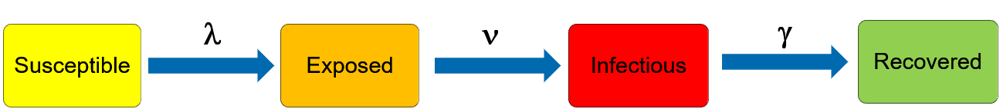
SEIR Model for Forecasting of COVID-19 Cases and Deaths
The SEIR Model Framework for COVID-19 Dynamics
Susceptible: Individuals who are not yet affected by COVID-19, but susceptible to the disease.
Exposed: Individuals who are infected by COVID-19, but not yet infectious themselves
Infectious: Individuals who have been infected by COVID-19 and capable of spreading the virus
Recovered: Individuals who are immune (or dead) that don’t contribute to further COVID-19 transmission
λ “Force of infection”
= β I under density-dependent transmission
= β I/N under frequency-dependent transmission
ν − Rate of progression to infectious state = 1/latent period
γ − Rate of recovery = 1/infectious period
Differential Equations used for SEIR Modelling
Source: Compartmental models in epidemiology - Wikiwand
Notes:
There is a closed population and an initial number of infected people.
During each day, every infected person infects someone from the Susceptible group with some probability.
Someone from the Infected group recovers when the period of illness passes and moves to the Recovered group.
The algorithm goes like this for many days ahead
The model also accounts for the incubation/ latency period by introducing the Exposed group which can better characterize COVID-19.

Slide 43
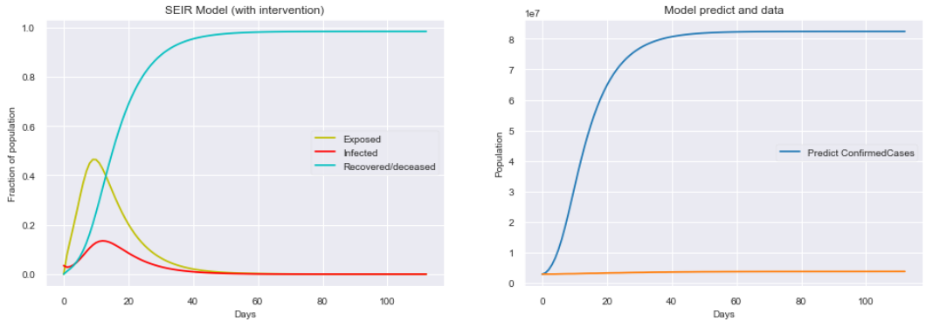
SEIR Model for Forecasting of COVID-19 Cases and Deaths
SIER model to predicts the rise in number of cases in Germany over 100 days. However, considering the fact that value of R₀ can fall to lower value due to enforcements like social distancing etc. This model should consider R_{t}(t) as a time varying variable.

Slide 44
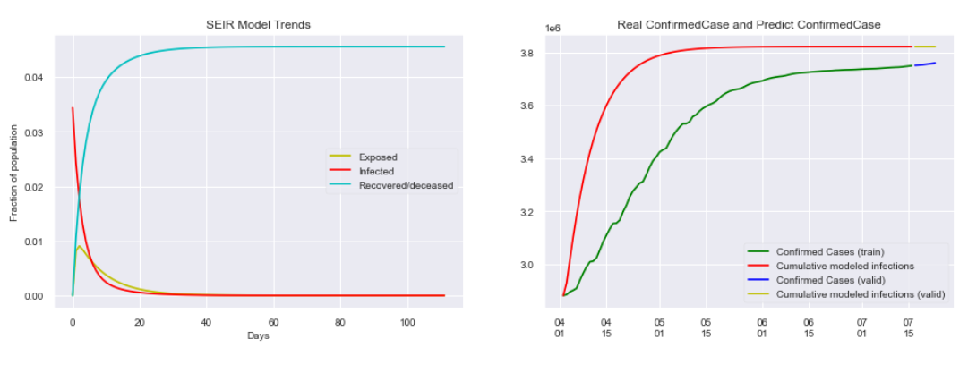
SEIR Model for Forecasting of COVID-19 Cases and Deaths
After Hyperparameter tuning to mimic the fall in the reproduction number (R_{t}(t)) over time the model introduces the Hill delay function to predict the COVID-19 cases more accurately in Germany by taking into account the ‘non-pharmaceutical interventions’ such as social distancing, lockdowns etc.

Slide 45
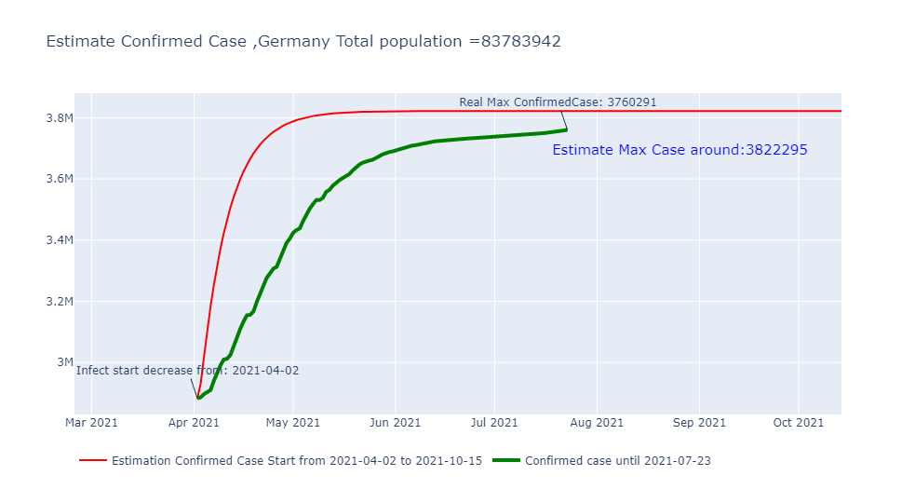
SEIR Model for Forecasting of COVID-19 Cases and Deaths
It is observed that SEIR model can predict COVID-19 cases with good accuracy over long-term (90-100 days) considering the characteristics of the delta variant’s rapid transmission and infection rates with the initial reproduction rate ~7.95, average incubation period as 8.5 and average infection period as 2.7.

Slide 46
Response Options AND Conclusion: German Government handling COVID-19
Protection: Vaccine Rollout in Germany
Containment: Non-pharmaceutical Interventions
Mitigation: Testing and Contact Tracing
Summary

Slide 47
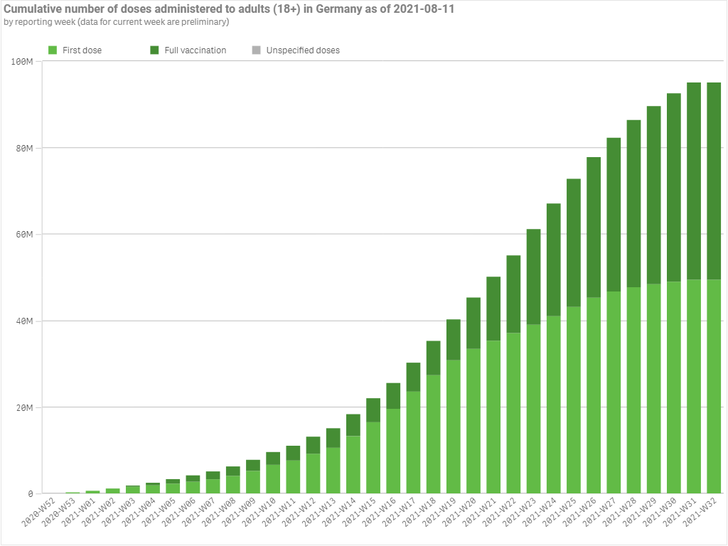
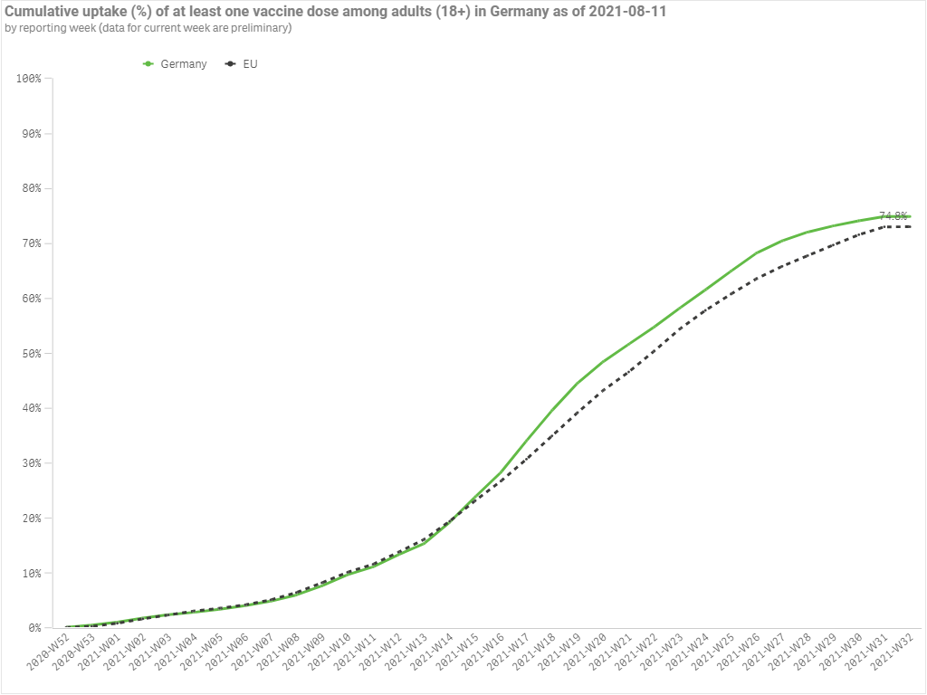
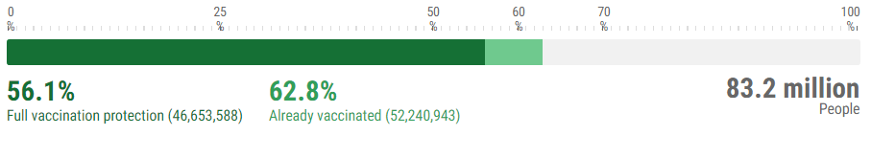
Protection: Vaccination Rollout in Germany
Cumulative Uptake (%) and Number of doses administered to adults in Germany
Acceleration of vaccine rollout in the shortest time possible to ensure all eligible individuals receive a full course vaccination to protect against the COVID-19 by immunization. Since, the Delta Variant is potentially more transmissible with increased severity it can greatly increase the risk of infection.
Source: COVID-19 Vaccine Tracker | European Centre for Disease Prevention and Control (europa.eu)

Slide 48
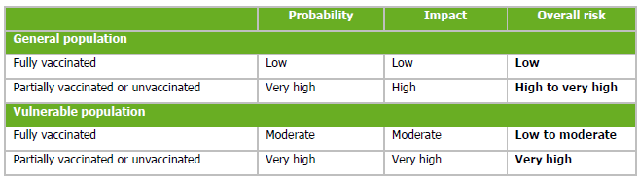
Protection: Vaccine Effectiveness and Number of Doses
Impact of Delta Variant on COVID-19 vaccine efficacy: One Dose vs Two Doses
The Characteristics of Delta Variant – Increased Transmissibility and severity that results in higher risk of hospitalizations and Lower vaccine effectiveness for symptomatic COVID-19 disease.
Vaccine effectiveness after one dose was lower for Delta variant infection (33.5%) compared to Alpha variant infection(51.1%).
Vaccine effectiveness after second dose was for Delta variant infection (87.9%) compared to Alpha variant(93.4%).
Full vaccination provides nearly equivalent protection against the Delta VOC as for the Alpha VOC.
Source: Threat Assessment Brief: Implications for the EU/EEA on the spread of the SARS-CoV-2 Delta (B.1.617.2) variant of concern (europa.eu)

Slide 49
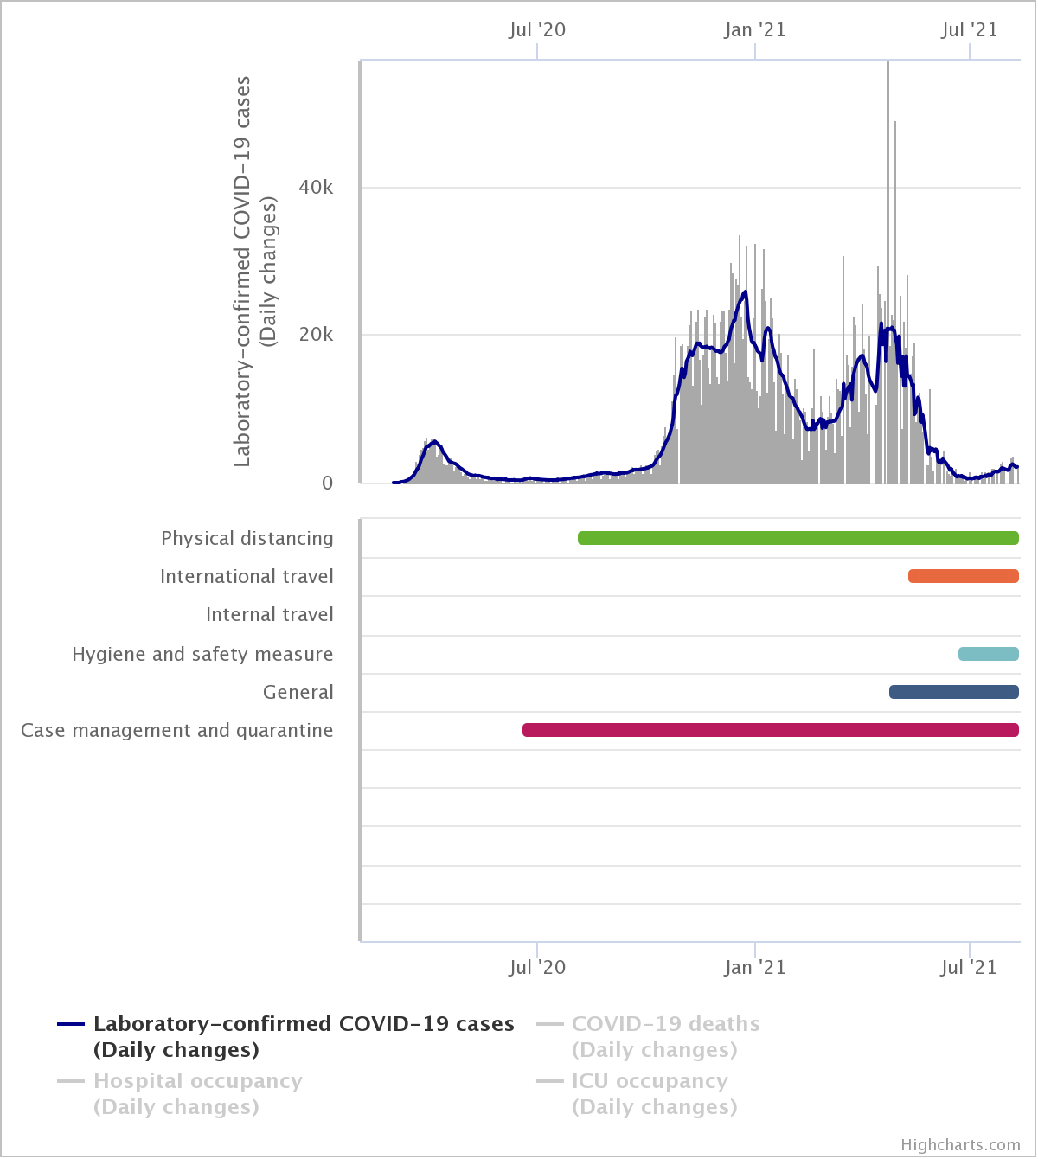
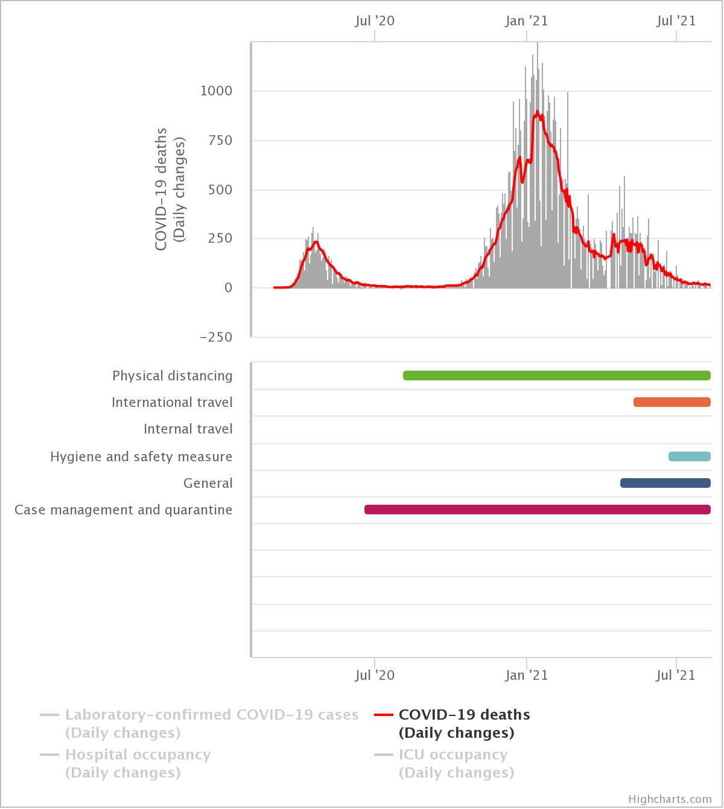
Containment: Non-pharmaceutical Interventions
Decrease in
deaths due
to International
travel & General
restrictions
Decrease in
cases due
to International
travel & General
restrictions
Enforcement of Non-pharmaceutical interventions should be maintained by taking into account of the analysis trend of the Delta variant. Restriction of International Travel measures plays an essential role in containment the spread of Delta variant infection from countries like United Kingdom, India and so on.
Source: Measures List - Ecml Covid (europa.eu)

Slide 50
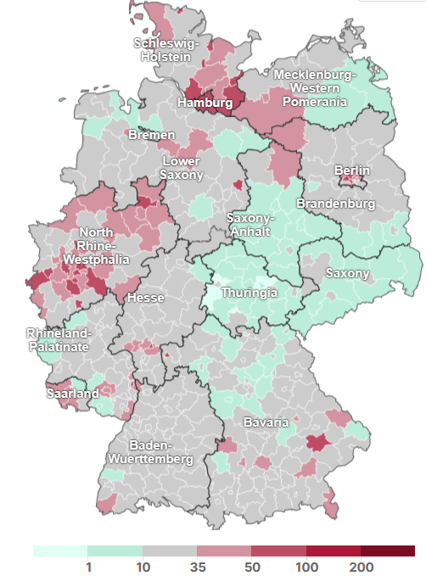
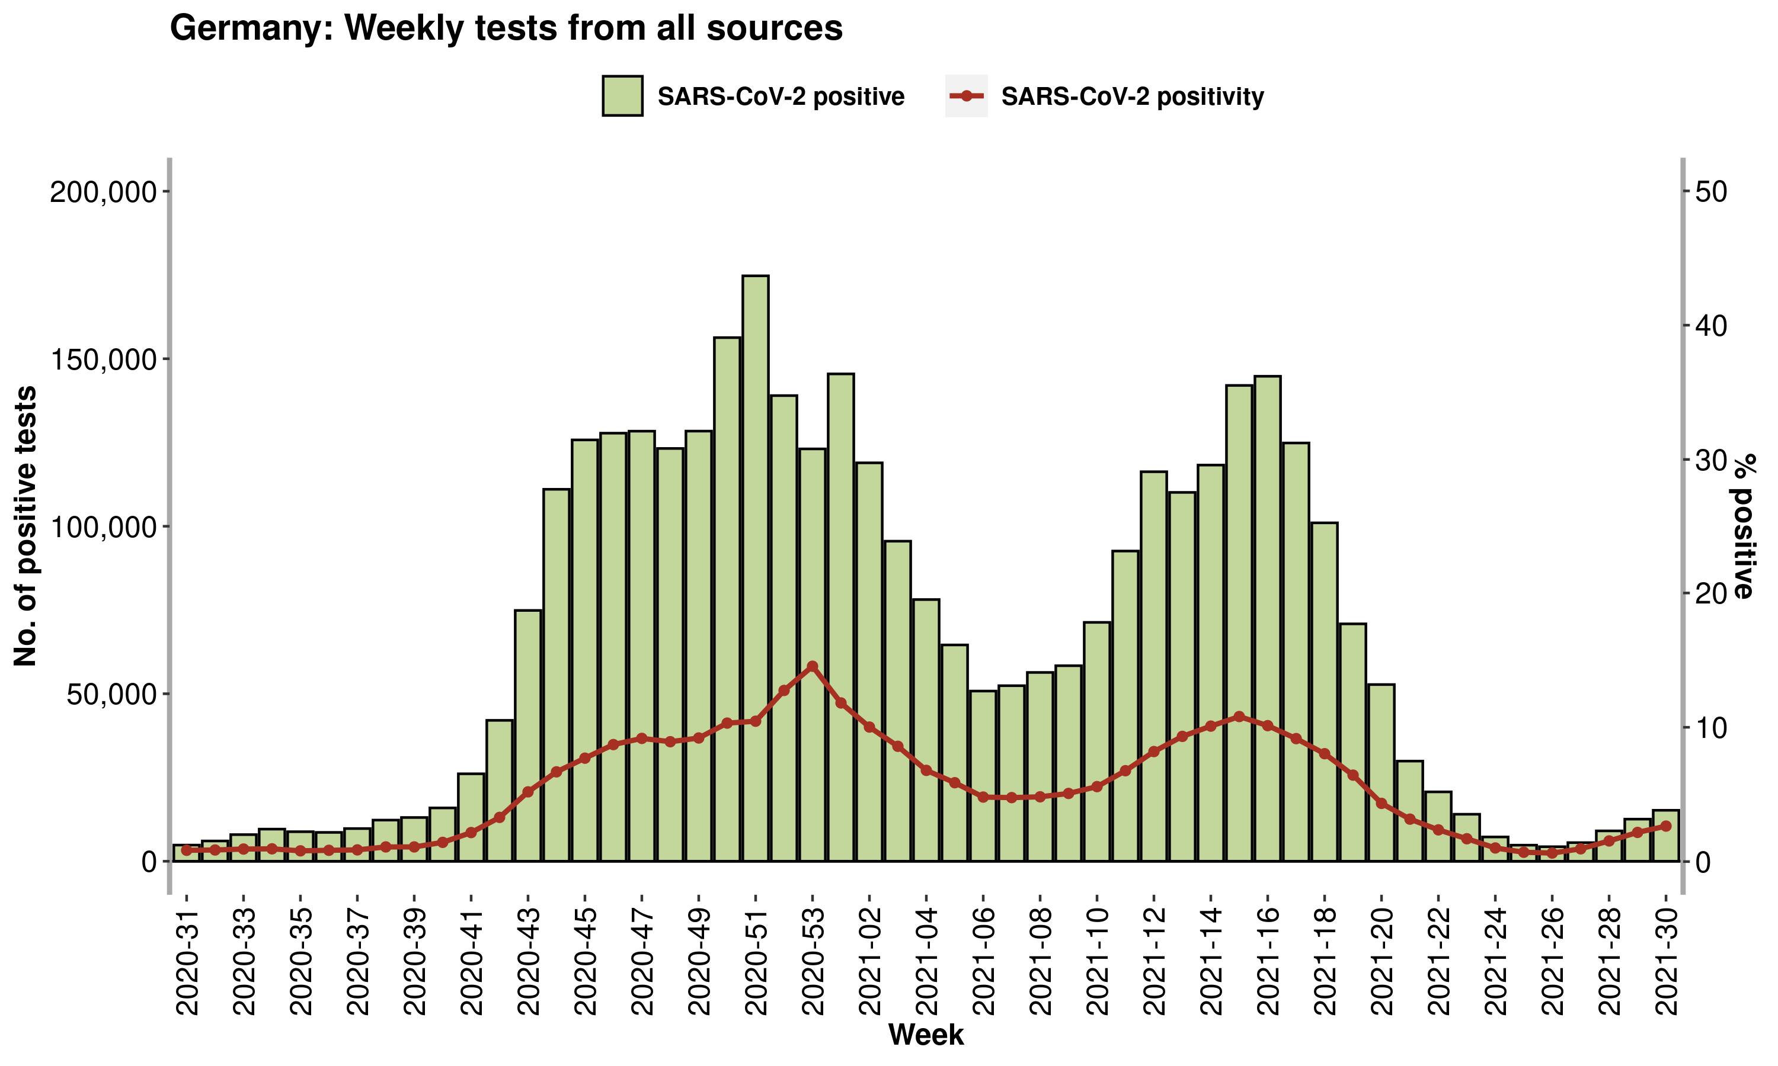
Mitigation: Testing and Contact Tracing
Weekly Testing and New Infections within the Last 7 days
Improved weekly testing strategies and Sequencing is of high importance for early detection and monitoring for targeted COVID-19 variant (Delta). Contact Tracing remains a key mitigation tool to break transmission chains. It helps in effective outbreak management during current phase of COVID-19 spread.
Source ECDC-WHO/Europe COVID-19 Surveillance Explorer (shinyapps.io), Berliner Morgenpost

Slide 51
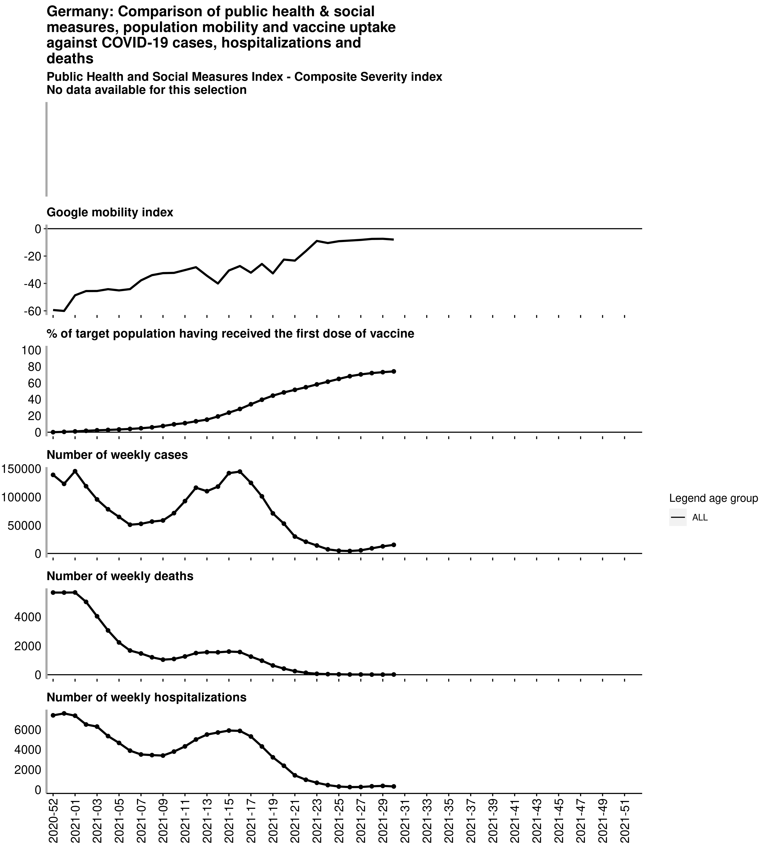
Summary
Comparison of risk control measures vs COVID-19 cases, deaths and hospitalizations
The overall risk related to Delta Variant is expected to increase for the general population since, Delta variant is 40-60% more transmissible than the Alpha variant.
Individuals with only one dose are less protected against Delta variant. Full vaccination provides better immunity and protection against the Delta variant.
Non-pharmaceutical interventions should be maintained at a level sufficient to contain community transmission of the Delta VOC until greater shares of the population are fully vaccinated, in order to avoid a resurgence of cases.
Targeted surveillance through contact tracing of the Delta variant which is currently circulating is of significance for early detection and monitoring of emerging Delta variants.
Source: ECDC-WHO/Europe COVID-19 Surveillance Explorer (shinyapps.io)
Notes:
Relaxation could lead to fast and significant increase in daily cases which in turn lead to higher hospitalization rates and eventual increase in deaths.
Non-pharmaceutical interventions should be maintained at a level sufficient to contain community transmission of the Delta VOC until greater shares of the population are fully vaccinated, in order to avoid a resurgence of cases with a possible increase in hospitalisations and mortality.

Slide 52
Thank you for your Attention

